Slide 1
Smart Vacuum Robot
Submitted To : Dr. Ashima Singh | Submitted By: Jhonsy Bansal (801732025) Gurkirat Singh (801832016) Harmandeep Singh (801832018) Kamal Kant (801832023)

Slide 2
Table of Content
Background of project and existing work
Scope and Utility of the project
Objectives
Architecture of the project
Techniques and tools used
Most relevant snapshot of the project
Professional and technical learning
Internal View
Circuitry
Flow chart
Key highlights of project/outcomes
Video
Individual roles and learning outcomes

Slide 3
Background of project and existing work
Major attention in robotics research with IOT due to its effectiveness in assisting humans.
Existing robots are either too expensive or sophisticated that cannot be used in general.
Our robot will be fully autonomous and making decisions on the basis of the outputs of various sensors after being processed by Arduino controller and control the actuators by the H-bridge driving circuitry and it can even operated by the the app over the internet.
Some of the existing work
Roomba - 2002, iRobot (American)
Scooba - 2005, iRobot (American)
Braava - 2006, Neato-Robots XV series (California)/China
Neato XV-11 - 2010, Neato-Robots XV series (California)/China
EYE-360 - 2016, Dyson (UK)
Notes:
In recent years, robotic cleaners have taken major attention in robotics research due to their effectiveness in assisting humans in floor cleaning applications at homes, hotels, restaurants, offices, hospitals, workshops, warehouses and universities etc.

Slide 4
Scope and Utility of the project
Scope
Assemble & Integrate the different parts together.
Calibration of hardware with coding.
Connect the device with Internet and operate it through app.
Utility
Fully Autonomous
IOT Enabled
Notes:
Scope include the tasks we have to perform and their boundries or goals that need to be met to achieve a satisfactory result

Slide 5
Objectives
Connecting and Assembling hardware.
Circuit and pin configuration
Assemble component into the model
Calibrating Hardware.
Arduino Uno Configuration and Coding
Enable IoT (working).
Flashing ESP8266 wifi module.
Configure Blink App

Slide 6
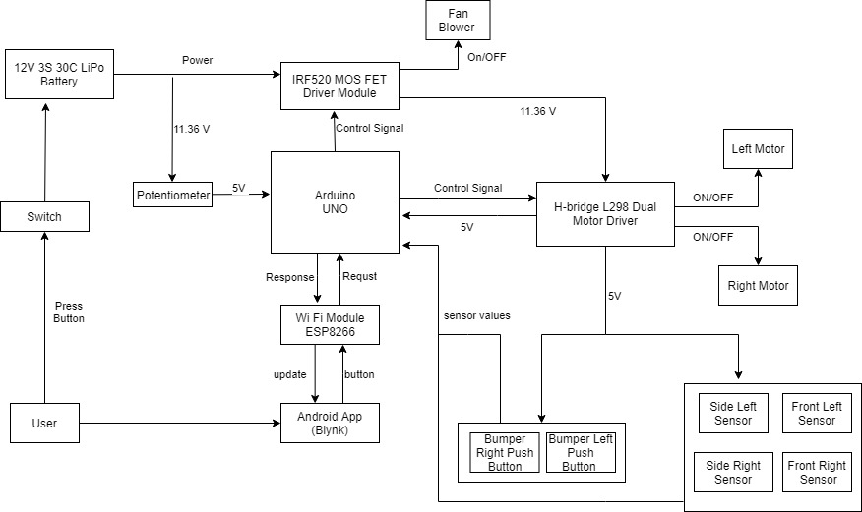
Architecture of the project (Block diagram)

Slide 7
Technique and Tools used
Techniques
Iterative Technique
Tools
Slack - for group discussion
Arduino Board - to control everything
Motor Driver - to control motors
Arduino IDE - For Arduino UNO programming
GItHub - Version control system
ESP8266 - wifi module
Notes:
A tool is a device or computer app that enables you do do something. For example, a microscope or a modeling program. A technique is a process or procedure that you follow. For example there are guidelines for how to construct an effective scientific experiment such as you make sure the participants are unbiased.

Slide 8
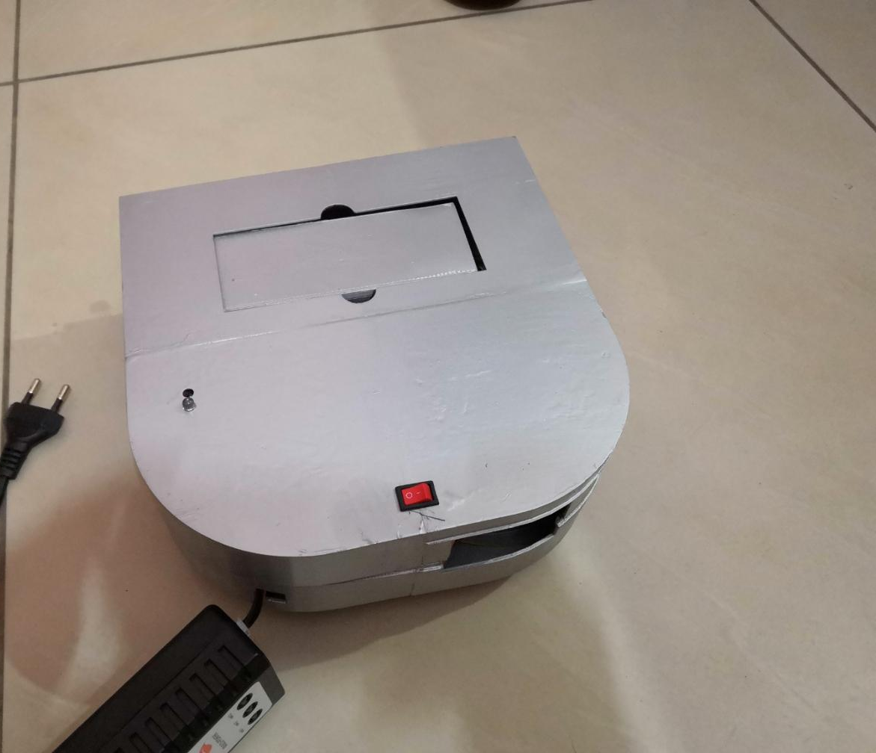
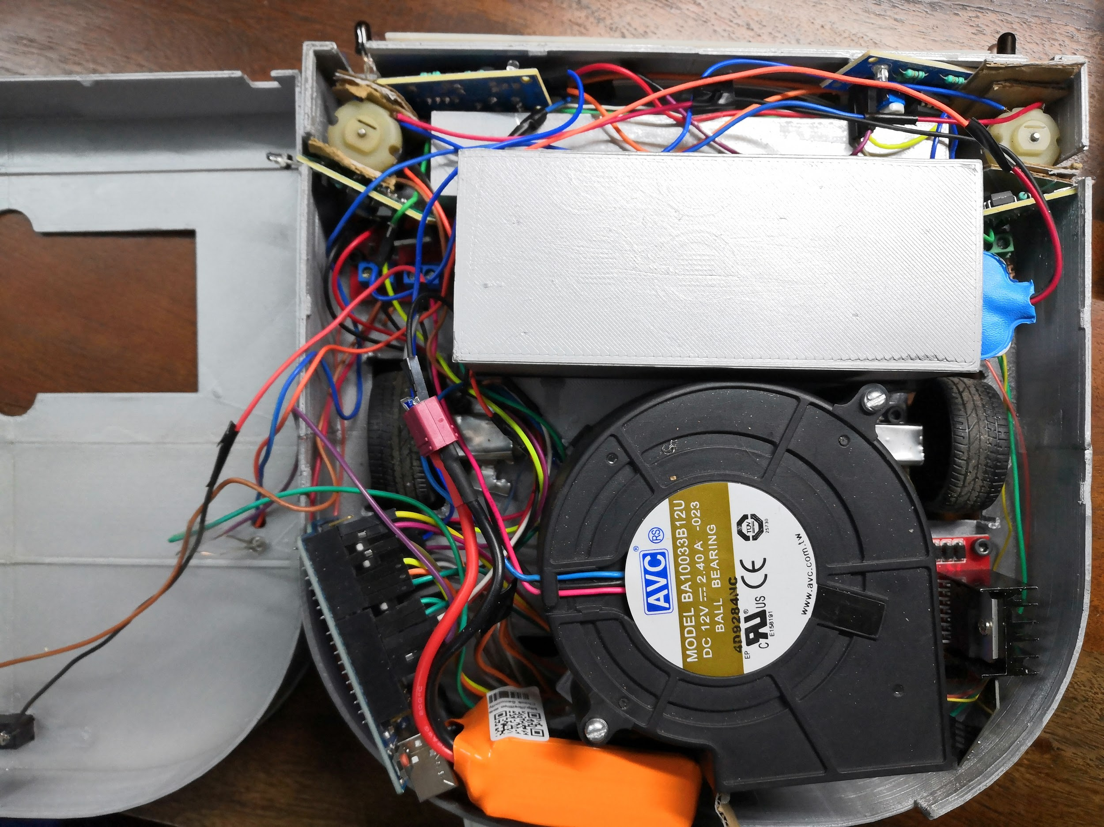
Most relevant snapshot of the project

Slide 9
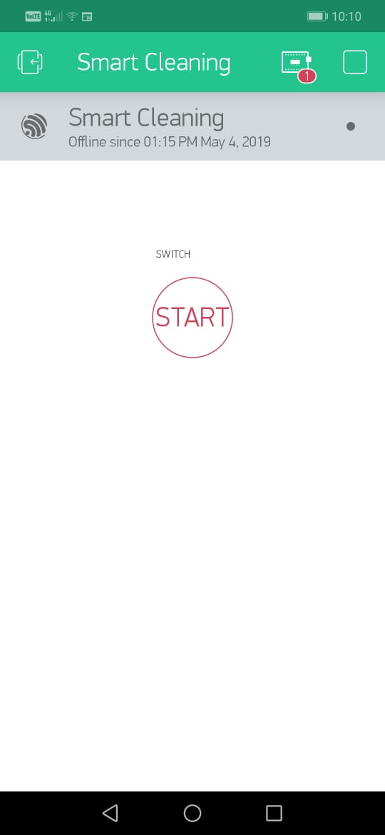
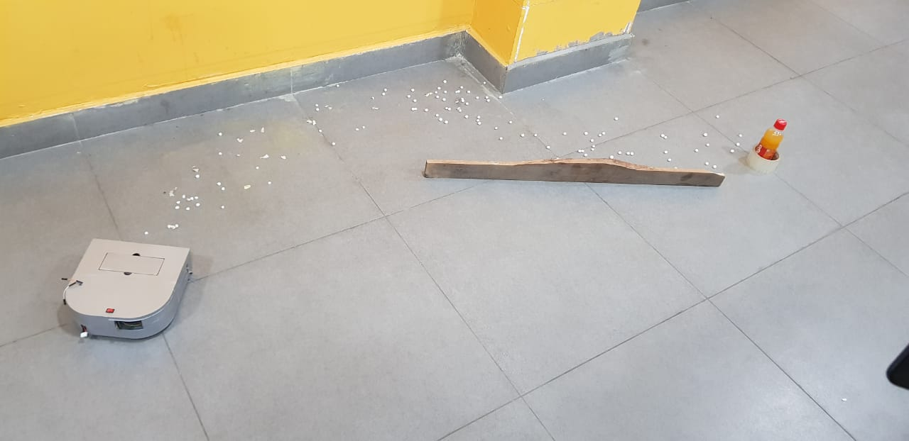
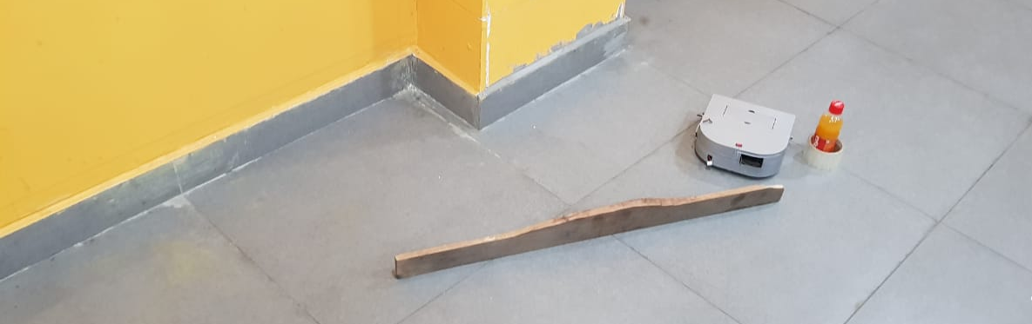
Snapshot
BEFORE
AFTER
Android App

Slide 10
Professional and technical learning
Professional Learning
Team work
Leadership
Communication
Technical Learning
Circuit Implementation
Arduino Programming
Internet of things

Slide 11
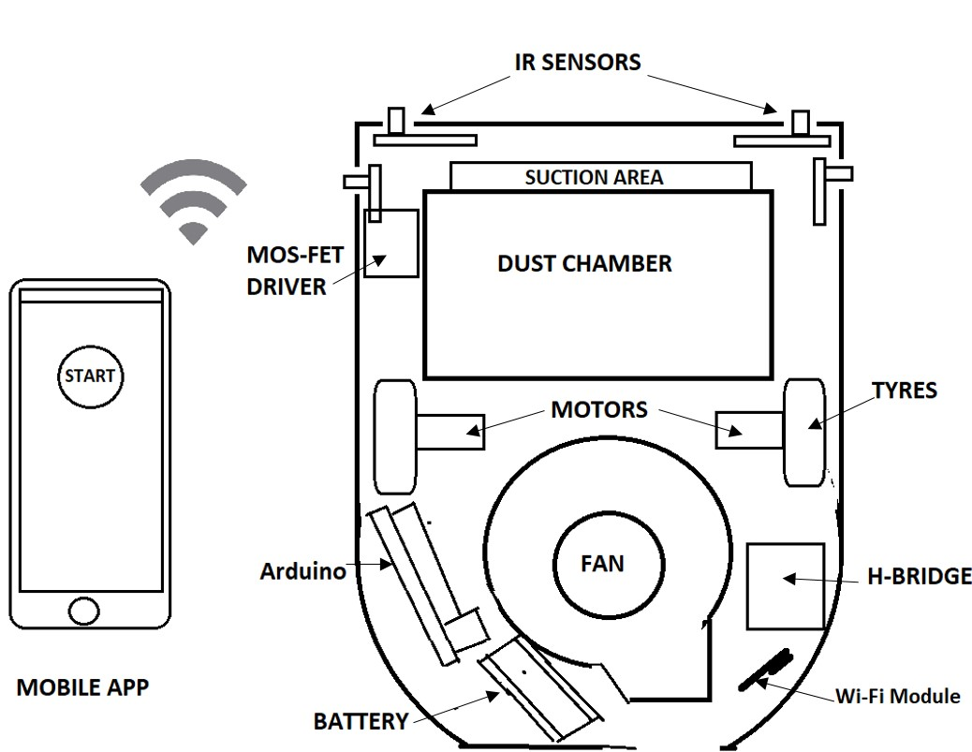
Internal Structure

Slide 12
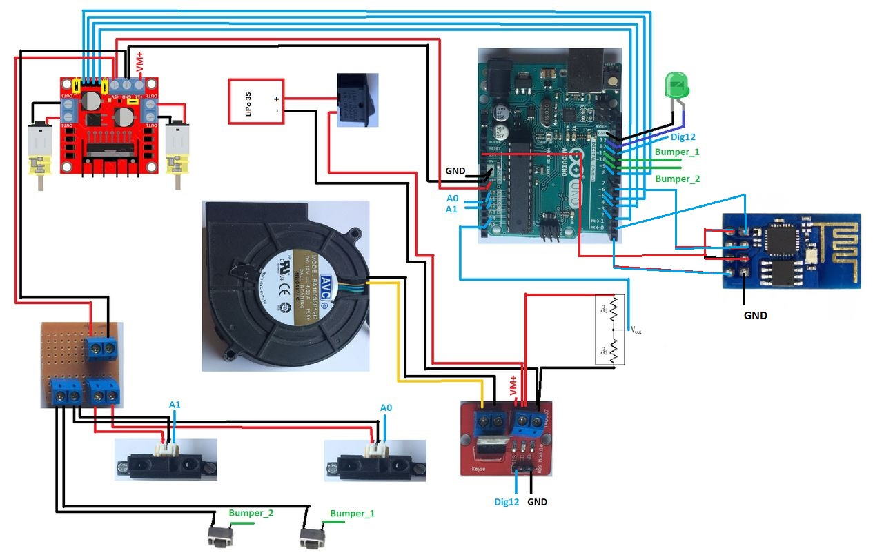
Circuit Diagram

Slide 13
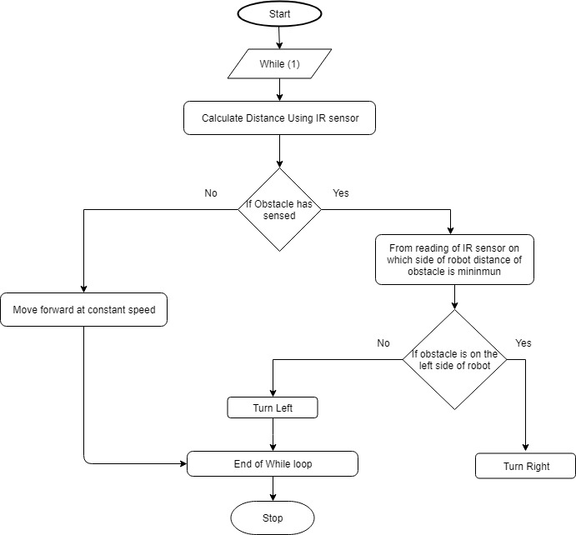
Flow diagram

Slide 14
Key Highlights of the Project
Autonomous with collision detection
Robotic Cleaning solution at cheaper cost
Small and intelligent
Controlled through Mobile App through internet
IOT enabled

Slide 15
Video

Slide 16
Individual Roles and learning Outcomes
Individual Roles
Modules listing and Collection - Harmandeep
Modules integration and assembling - Gurkirat
Coding and calibration - Kamal Kant
Reporting and testing - Jhonsy Bansal
Learning Outcomes
Controlling hardware by programming
Evaluation of the parameters
Use of various activities (UML) while developing project
Understanding the factor affecting the project and how to develop successful project

